Slide 1
Introduction to Statistical Methods
ISM Team

Slide 2
Session 3
(8th / 9th November,2025)
Conditional Probability & Bayes theorem

Slide 3
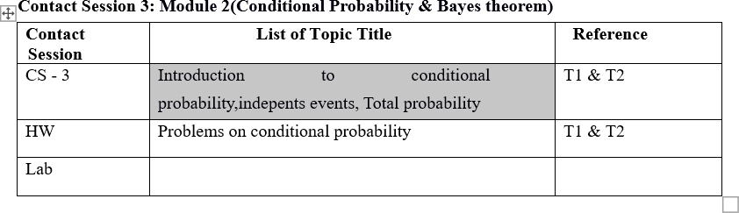
Contact Session 3

Slide 4
Agenda
Conditional Probability
Independent Events
Total Probability

Slide 5
Conditional Probability
The probabilities assigned to various events depend on the experimental situation when the assignment is made.
Subsequent to the initial assignment, partial information relevant to the outcome of the experiment may become available.
Such information may cause us to revise some of our probability assignments.

Slide 6

Conditional Probability: Example
We examine how the information “an event A has occurred” affects the probability assigned to B.
For example, B might refer to an individual having a particular disease in the presence of certain symptoms.
If a blood test is performed on the individual and the result is negative, then the probability of having the disease will change (it should decrease, but not usually to zero, since blood tests are not infallible).
We will use the notation to represent the conditional probability of B given that the event A has occurred. A is the “conditioning event.”

Slide 7







Conditional Probability
Let A and B be two events in a sample space . The conditional probability that event B occurs given that event A has occurred is denoted by B / A ( B given A – not to read this as B by A) and its probability is
The conditional probability that event A occurs given that event B has occurred is denoted by A / B and its probability is
From these we can also have

Slide 8
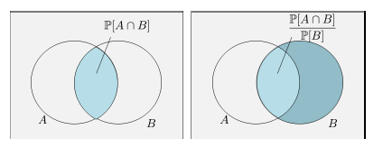
Conditional Probability

Slide 9
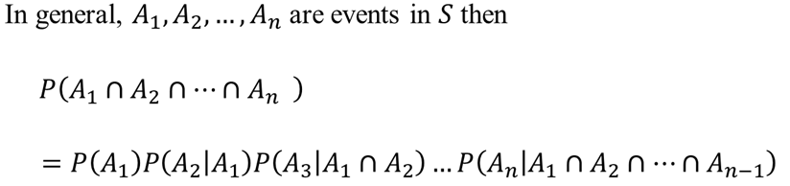


Multiplication rule
Let A,B and C be three events in a sample space S, then P(A∩B∩C) = P(A) P(B|A) P(C|A∩B) and it is called multiplication rule

Slide 10







Example - 1
Following table contains the different age group peoples who have defaulted and not defaulted on Loans.
What is the probability that a person will not default on the loan given he/she is middle-aged?
What is the probability that a person is middle-aged given he/she has not defaulted on the loan?
 |  | Age
 |  | Young | Middle-Aged | Senior citizens | Total
Loan Default | No | 10503 | 27368 | 259 | 38130
 | Yes | 3586 | 4851 | 120 | 8557
 | Total | 14089 | 32219 | 379 | 46687

Slide 11
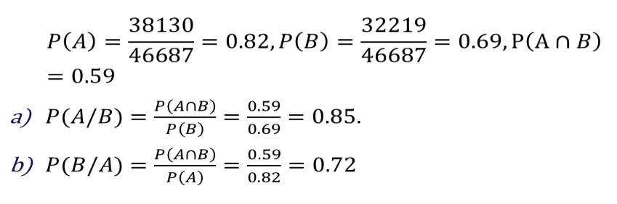





 |  | Age
 |  | Young | Middle-Aged | Senior citizens | Total
Loan Default | No | 10503 | 27368 | 259 | 38130
 | Yes | 3586 | 4851 | 120 | 8557
 | Total | 14089 | 32219 | 379 | 46687
Let A denote the event that a person will not default on the loan And B be the event that he /she is middle aged

Slide 12
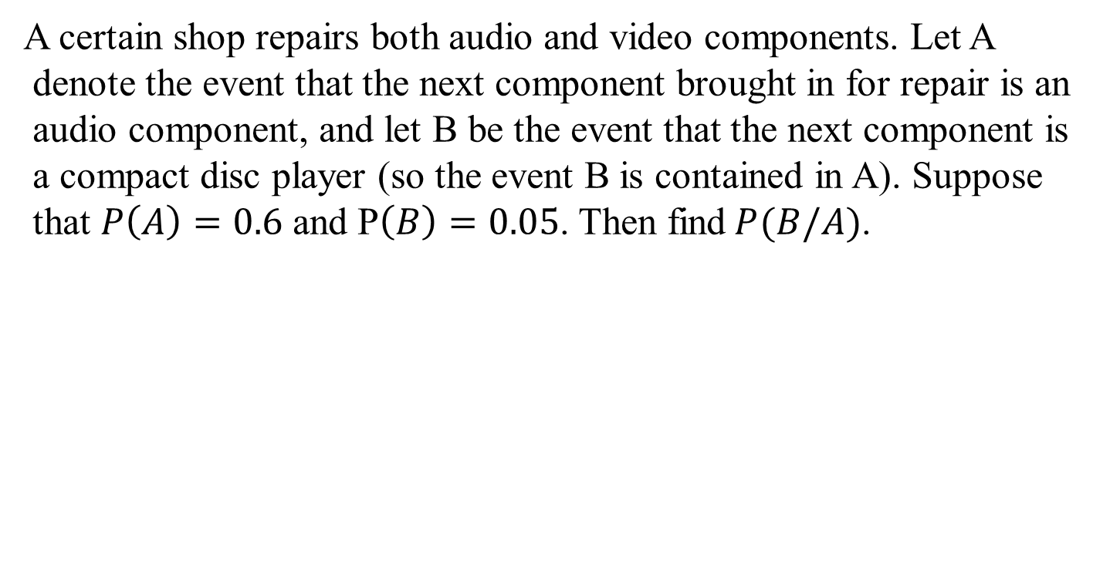
Example - 2

Slide 13
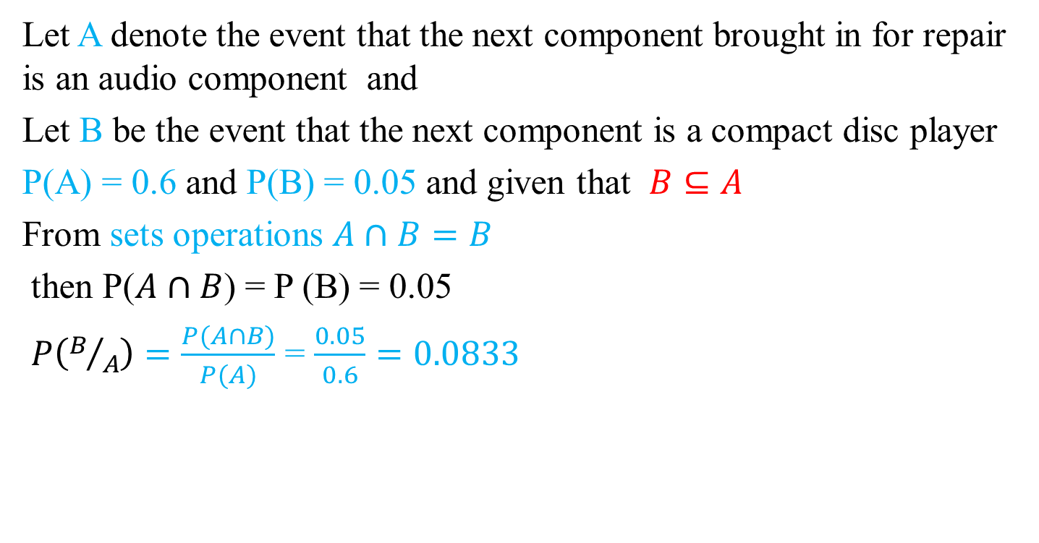




Solution

Slide 14
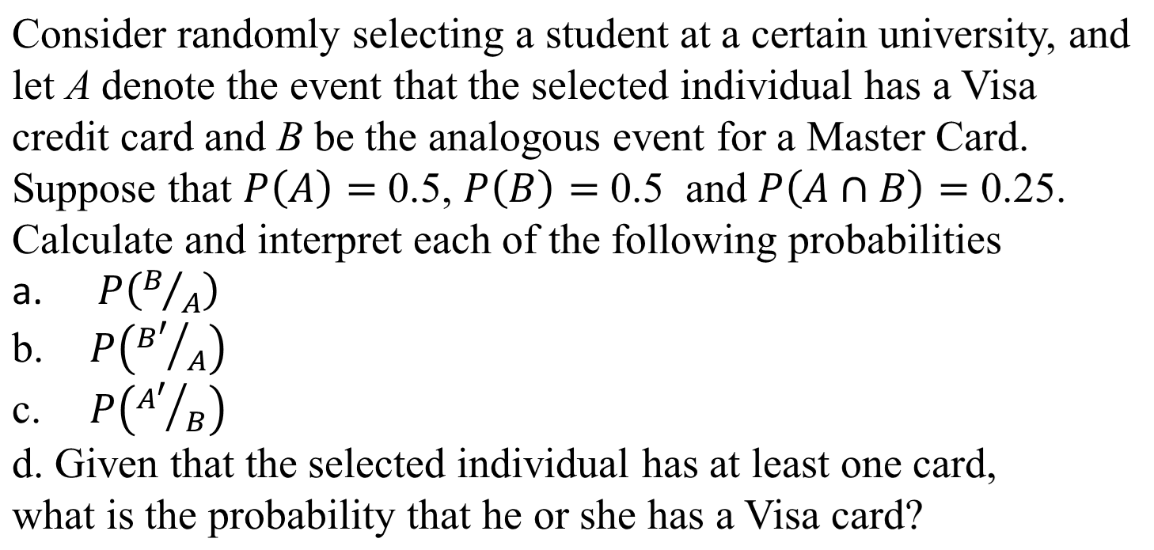
Example: 3

Slide 15
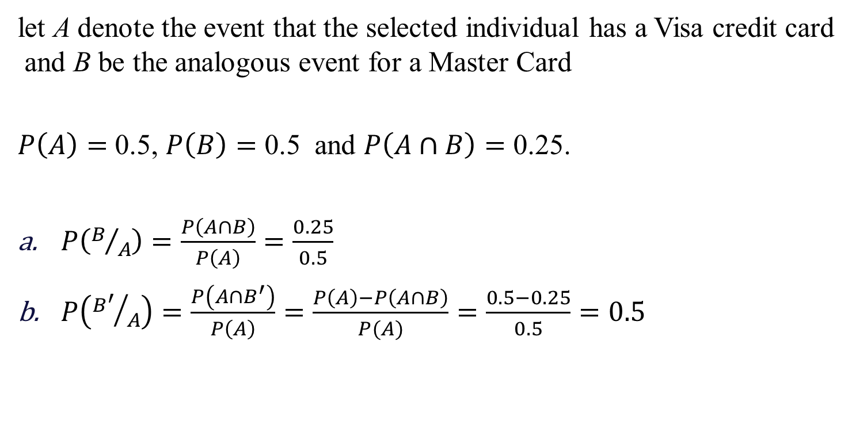









Solution

Slide 16
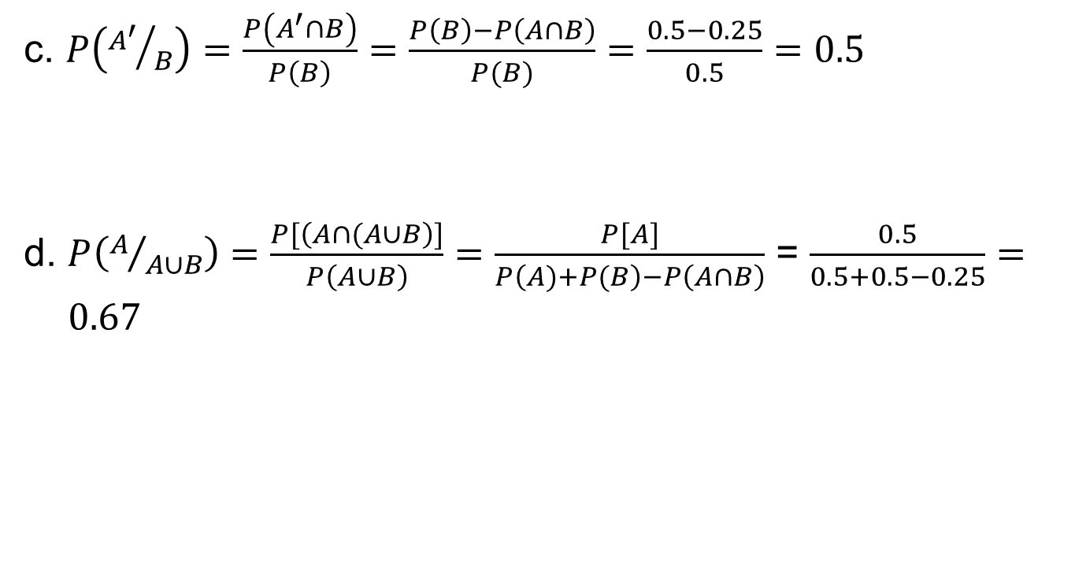
Solution:

Slide 17
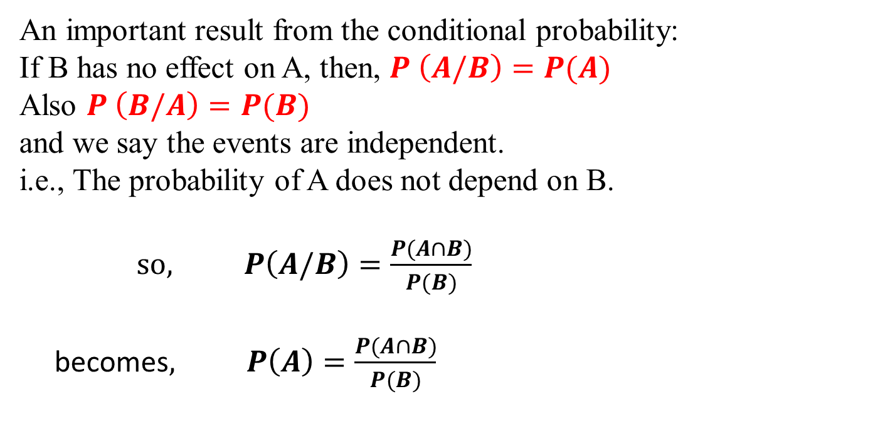






Independent Events
(Statistically Independent)
or P(A ∩ B) = P(A) × P(B)

Slide 18
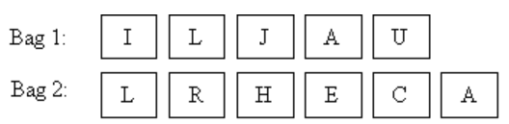












Example - 4
Two sets of cards with a letter on each card as follows are
placed into separate bags:
Bala randomly picked one card from each bag. Find the probability that:
a) He picked the letters ‘J’ and ‘R’.
b) Both letters are ‘L’.
c) Both letters are vowels.

Slide 19
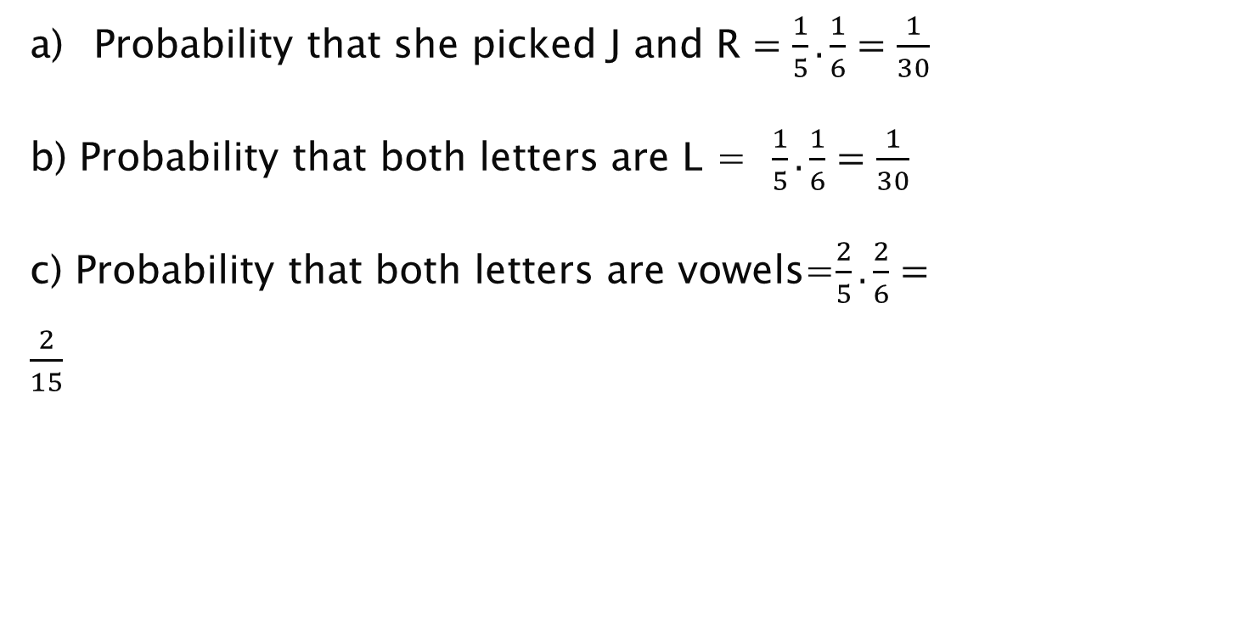


Solution

Slide 20



Example- 5
In a group of 300 all adults, 272 are right-handed, 3 adults
are selected with replacement. Find
P(all 3 are right- handed)
P(all 3 left-handed)
P(At least one right-handed)
Solution:
P(one right-handed) = 272/300 =0.907
P(one left-handed) = (300-272)/300 = 28/300 = 0.093

Slide 21











Solution
a) P(3 right-handed) = (272/300) (272/300)(272/300)
= (272/300)³ = 0.745
b) P( 3 left-handed) = (28/300)(28/300)(28/300) = (28/300)³
= 0.0008
c) P(At least one right-handed) = 1 – P(All 3 left-handed)
= 1 - 0.0008
= 0.9992

Slide 22


Example- 6
A data science team is working on a model to predict whether an email is spam or not. They are using two independent features: The presence of the word "offer“ (Feature A) and the presence of a suspicious link (Feature B).
The probability that an email contains the word "offer“ (Feature A) is 0.6.
The probability that an email contains a suspicious link (Feature B) is 0.4.
What is the probability that an email contains both the word "offer" and a suspicious link?
What is the probability that an email contains either the word "offer" or a suspicious link or both?
What is the probability that an email contains neither the word "offer" nor a suspicious link?

Slide 23
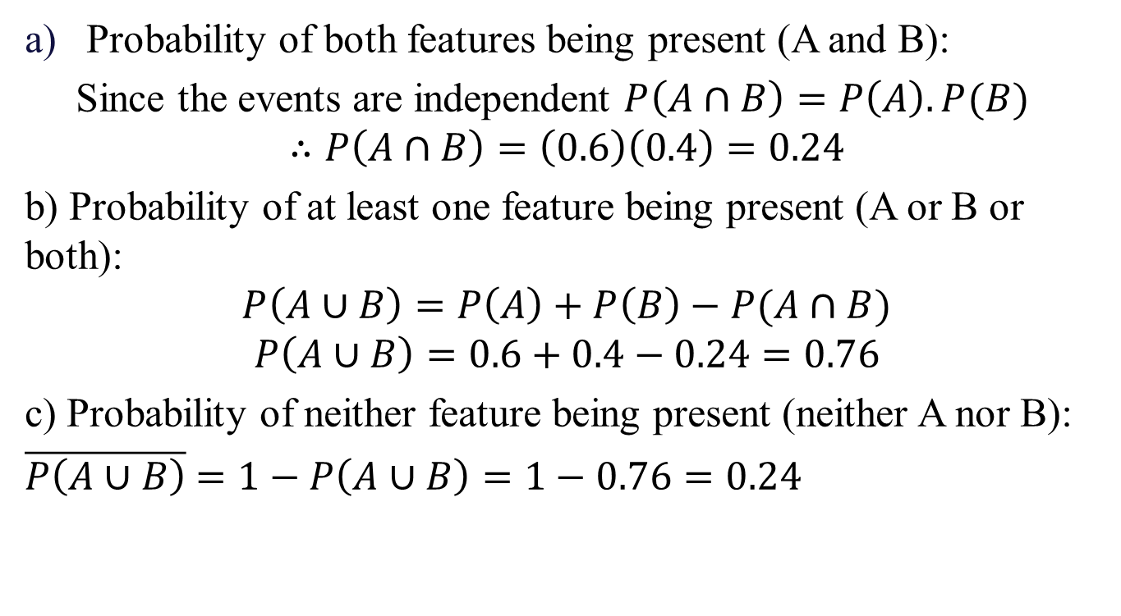



Solution

Slide 24
Miscellaneous Examples
1. In a jar with 5 red, 6 blue and 2 white marbles. Two marbles are selected, find the probability that both are red if:
a) If two marbles are selected with replacement.
b) If two marbles are selected without replacement.
2. In batch of 6400 light bulbs, 80 are defective. If 12 light bulbs are selected from the batch without replacements, find probability that all are good.
3. In a city with two airports, 100 flights were surveyed. 20 of those flights departed late. 45 flights in the survey departed from airport A; 9 of those flights departed late.55 flights in the survey departed from airport B; 11 flights departed late.Are the events "depart from airport A" and "departed late" independent?

Slide 25
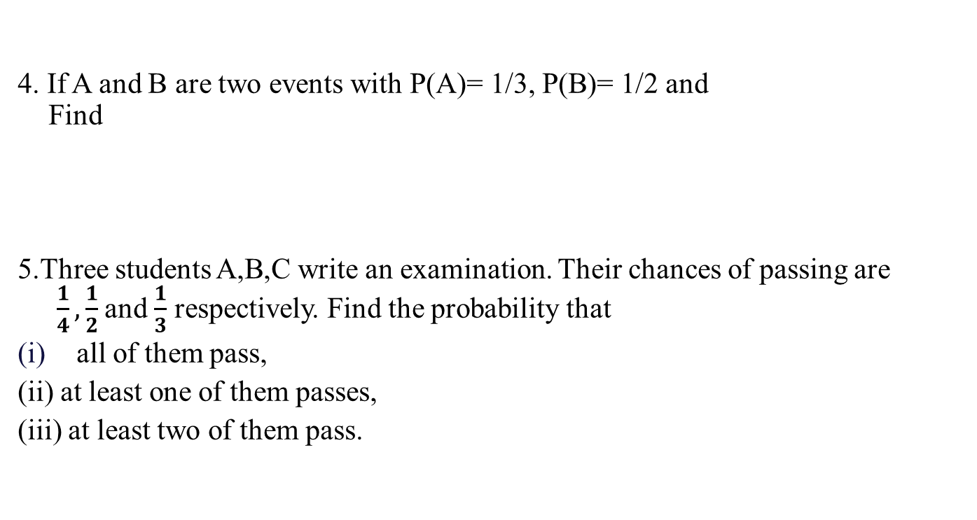
Contd….

Slide 26
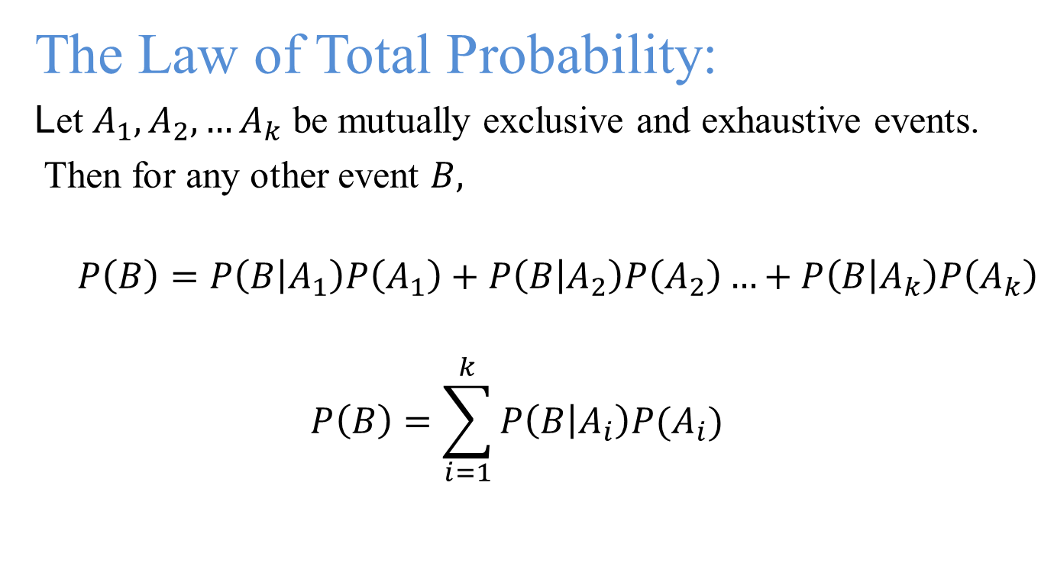
Total Probability

Slide 27











S= A₁ U A₂ U … U A_{k}
and A₁ ∩ A₂ ∩ … ∩ A_{k} =∅
B
𝐴₅
S
𝐴
1
𝐴₃
𝐴₄
𝐴₂
𝐴₆
𝐴_{𝑘}
∴ B = B ∩ S = B ∩{A₁ ∪ A₂ ∪ A₃ , . . . ∪ A_{k} }

Slide 28
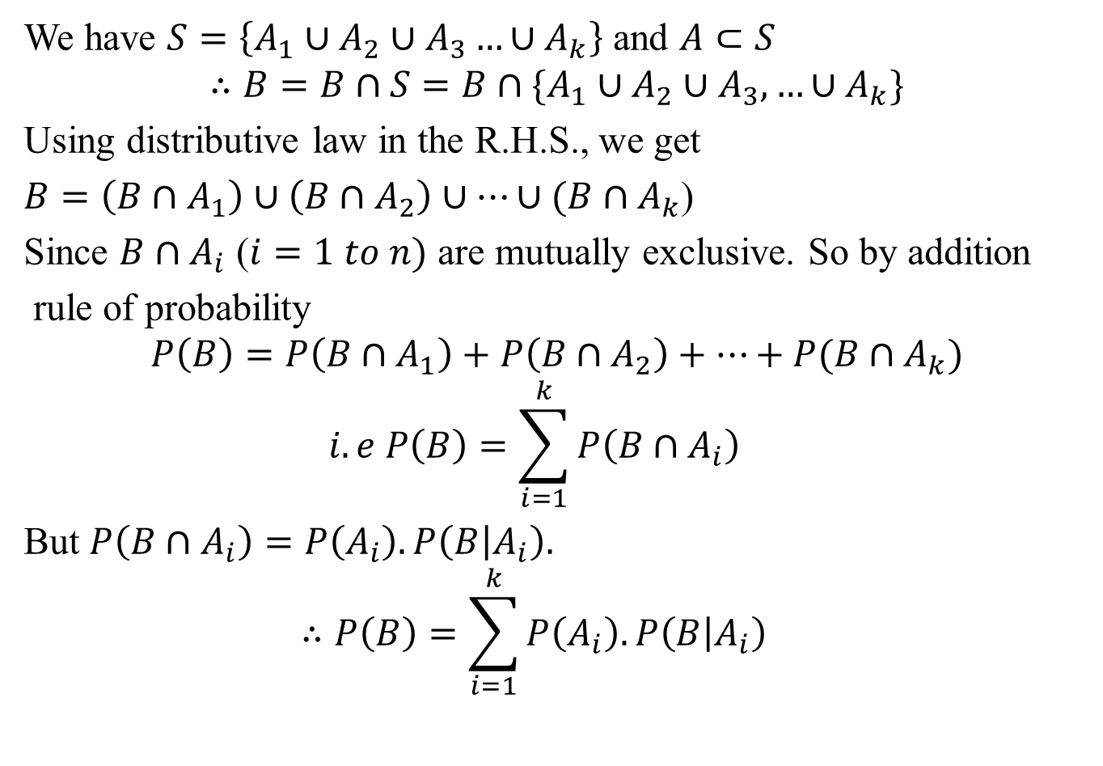

Proof

Slide 29





The theorem of total probability
(Tree Diagram)
B
A₁
A₂
A₃
A_{k}

Slide 30
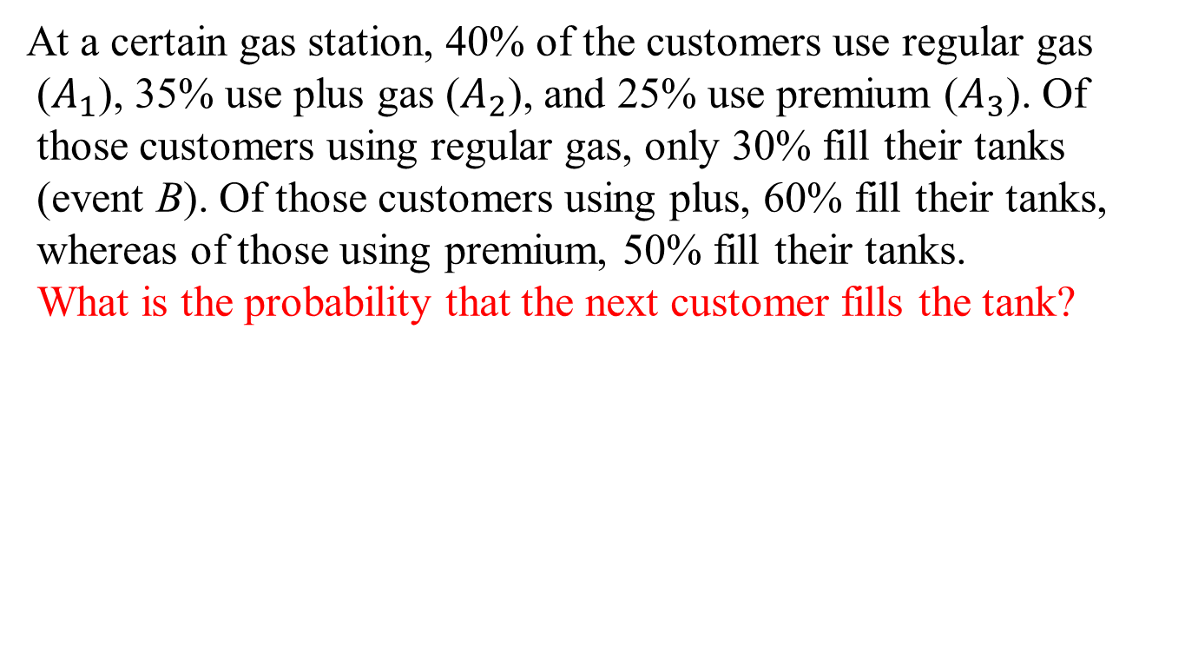














Example-1

Slide 31
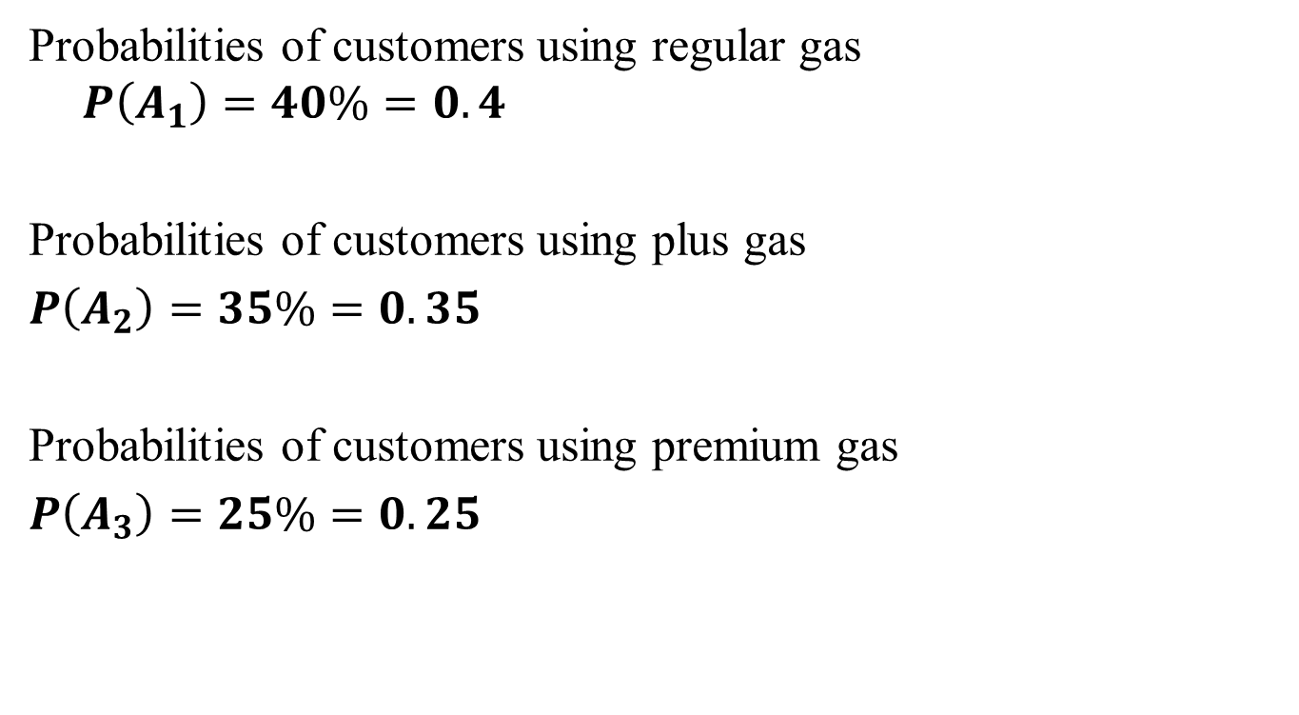
Solution

Slide 32
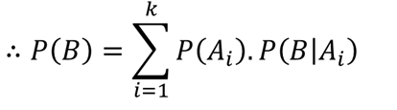
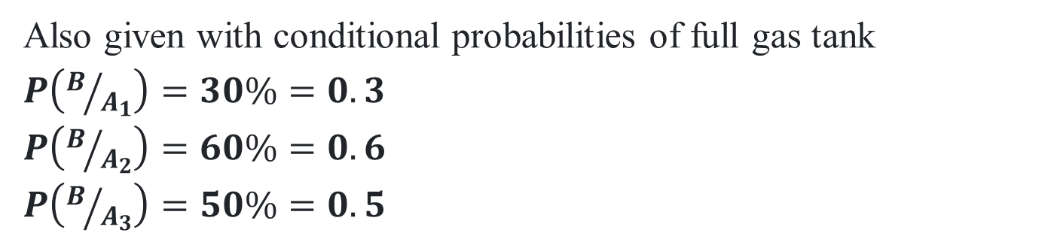
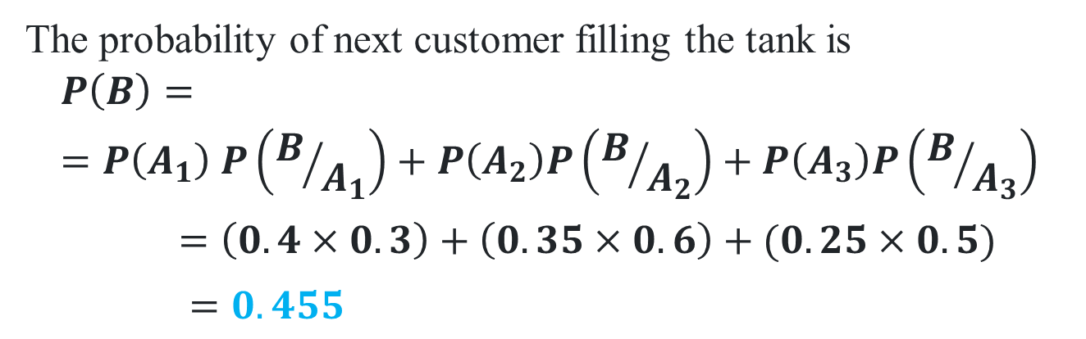





Slide 33
Example-2
A simple binary communication channel carries messages by using only two signals, say 0 and 1. For a given binary channel, 40% of the time a 1 is transmitted; the probability that a transmitted 0 is correctly received is 0.90, and the probability that a transmitted 1 is correctly received is 0.95. Determine
The probability of a 1 being received, and
Given a 1 is received, the probability that 1 was transmitted.

Slide 34
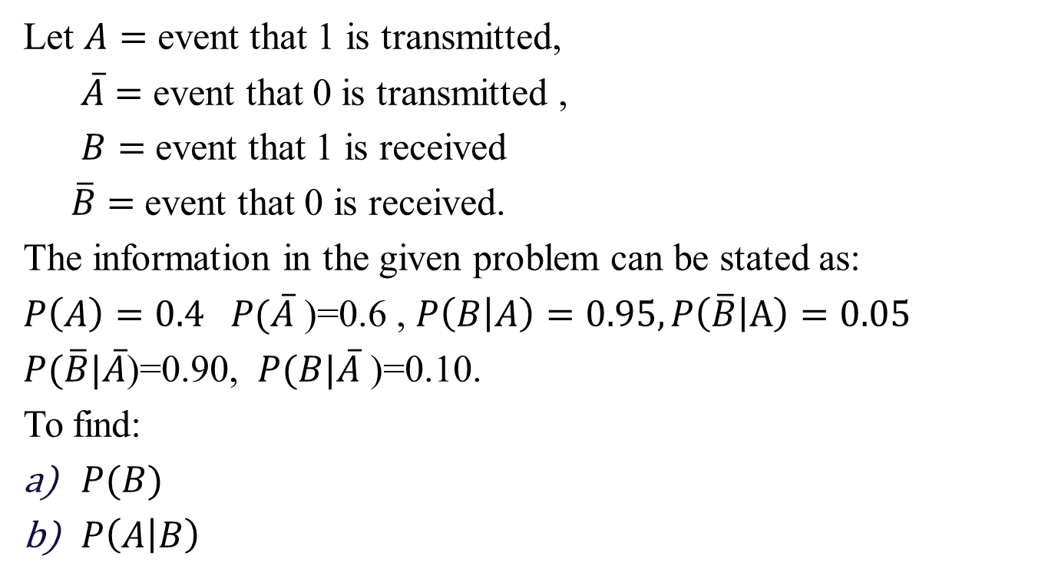
Solution

Slide 35
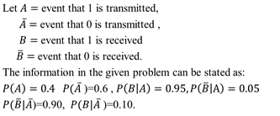
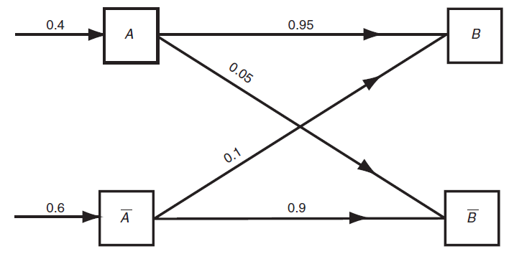
Solution
Probabilities associated with a binary channel

Slide 36
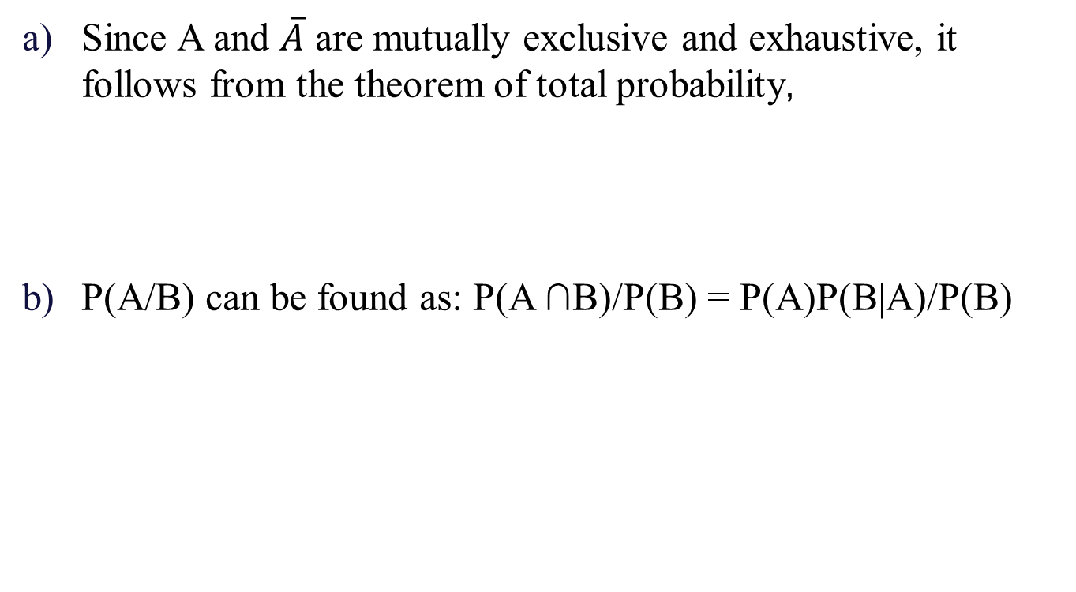


Slide 37
Example-3
A data science team is developing a predictive model to determine whether a user will click on an online advertisement. The likelihood of a user clicking on an ad depends on the type of device they are using. The team has categorized the devices into three types: desktop, tablet, and mobile.
The probabilities of a user using each type of device are as follows:
The probability that a user uses a desktop is 0.5.
The probability that a user uses a tablet is 0.2.
The probability that a user uses a mobile device is 0.3.
The probability of clicking on an ad given that the user is on a desktop is 0.04.
The probability of clicking on an ad given that the user is on a tablet is 0.06.
The probability of clicking on an ad given that the user is on a mobile device is 0.1.
What is the overall probability that a user will click on an ad?

Slide 38
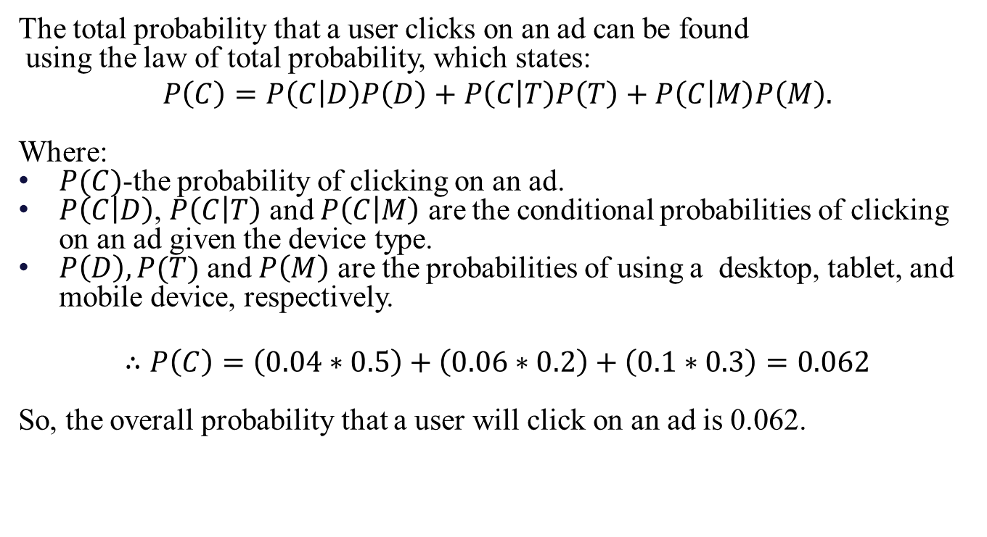
Solution

Slide 39
Example-4
Forest A occupies 50% of the total land in a certain park and 20% of the plants in this forest are poisonous.
Forest B occupies 30% of the total land and 40% of the plants in it are poisonous.
Forest C occupies the remaining 20% of the land and 70% of the plants in it are poisonous.
If we randomly enter this park and pick a plant from the ground, what is the probability that it will be poisonous?

Slide 40
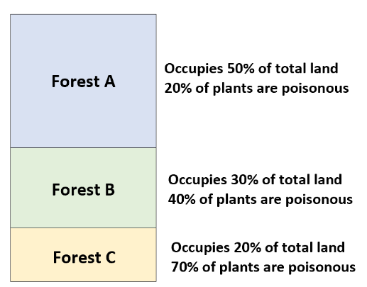
Given:

Slide 41
Solution
If we let P(P) = the probability of the plant being poisonous, and P(B_{i}) be the probability that we’ve entered one of the three forests, then we can compute the probability of a randomly chosen plant being poisonous as:
P(P) = ΣP(P|B_{i})*P(B_{i})
P(P) = P(P|B₁)*P(B₁) + P(P|B₂)*P(B₂) + P(P|B₃)*P(B₃)
P(P) = (0.20)*(0.50) + (0.40)*(0.30) + (0.70)*(0.20)
P(P) = 0.36

Slide 42
Example-5
A person has undertaken a mining job. The probabilities of completion of the job on time with and without rain are 0.42 and 0.90 respectively. If the probability that it will rain is 0.45, then determine the probability that the mining job will be completed on time.

Slide 43
Solution
Let A be the event that the mining job will be completed on time and B be the event that it rains. We have,
P(B) = 0.45,
P(no rain) = P(B′) = 1 − P(B) = 1 − 0.45 = 0.55
By multiplication law of probability,
P(A|B) = 0.42
P(A|B′) = 0.90

Slide 44
Solution
Since, events B and B′ form partitions of the sample space S,
by total probability theorem, we have
P(A) = P(B) P(A|B) + P(B′) P(A|B′)
=0.45 × 0.42 + 0.55 × 0.9
= 0.189 + 0.495 = 0.684
So, the probability that the job will be completed on time is
0.684.

Slide 45
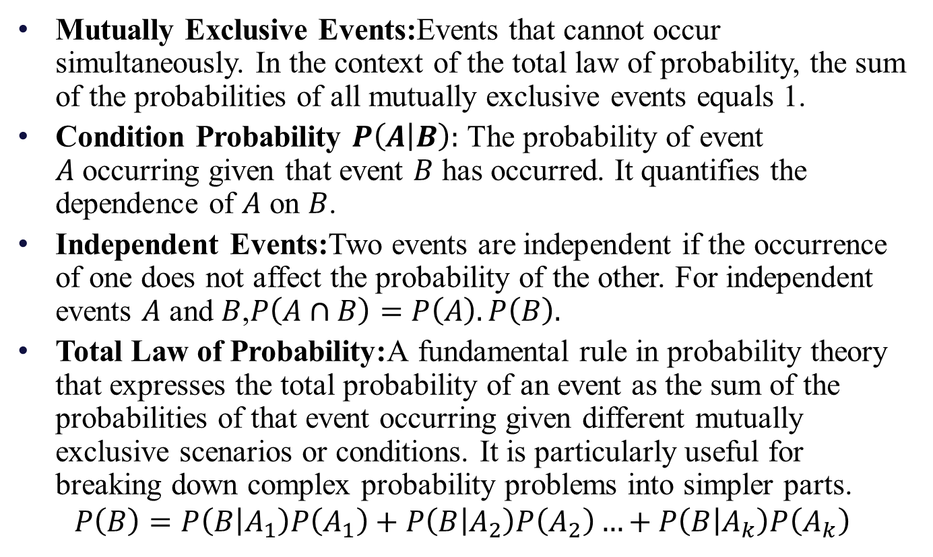
Glossary

Slide 46
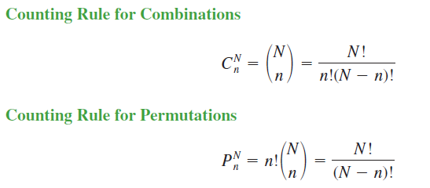
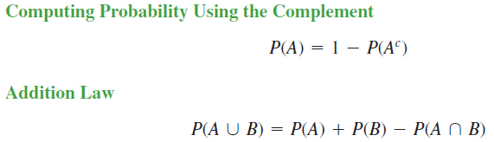
Important Formulae

Slide 47
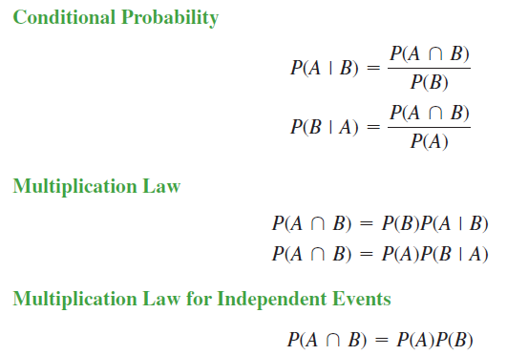

Important Formulae
$$∵P\left(B\right)P\left(B | A\right)=P\left(A\right)P\left(B | A\right)=P\left(A∩B\right)$$
$$⇒P\left(A | B\right)= \frac{P\left(A\right)P(A|B)}{P(B)} or P\left(B | A\right)= \frac{P\left(B\right)P(B|A)}{P(A)}$$

Slide 48
Practice Problems
Example 1.
An office has 4 secretaries handling respectively 20%, 60%,15% and 5% of the files of all government reports. The probability that they misfile such reports are respectively 0.05, 0.1, 0.1 and 0.05. Find the probability that the misfiled report can be blamed on the first secretary.
Ans: 0.1143
Example 2.
In a class 70% are boys and 30% are girls. 5% of boys and 3% of girls are irregular to the classes. What is the probability of a student selected at random is irregular to the classes and what is the probability that the irregular student is a girl?
Ans: P(Irregular Student) = 0.044, P( Irregular and Girl) = 0.009

Slide 49
Practice Problems
Example 3.
Three machines A, B and C produce respectively 60%, 30% and 10% of the total number of items of a factory. The percentage of defective outputs of these machines are 2%, 3% and 4%. An item is selected at random and is found to be defective.
(i) Find the probability that the item was not defective and produced by machine C?
Ans: 0.096
(ii) What is the probability that the item was produced by machine C or B? Ans: 0.4
Example: 4
A card is randomly drawn from an incomplete deck of cards from which the ace of diamonds is missing.
What is the probability that the card is “clubs”? ( Ans. 13/51)
What is the probability that the card is a “queen”? (Ans. 4/51)
Are the events “clubs” and “queen” independent (Ans. No)

Slide 50
Practice Problems
Example: 5
Three companies produce the same tool and supply it to the market. Company A produces 30% of the tools for the market and the remaining 70% of the tools are produced in companies B and C. 98% of the tools produced in company A, 95% of the tools produced in company B and 97% of the tools produced in company C are not defective. What percent of tools should be produced by companies B and C so that a tool picked at random in the market will have a probability of being non defective equal to 96%?
Ans: 0.164

Slide 51
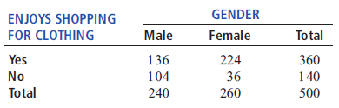
Practice Problems
Example: 6
A sample of 500 respondents was selected in a large metropolitan area to study consumer behavior, with the following results:
a. Suppose the respondent chosen is a female. What is the probability that she does not enjoy shopping for clothing? (Ans: 0.1384)
b. Suppose the respondent chosen enjoys shopping for clothing. What is the probability that the individual is a male?(Ans: 0.56)

Slide 52
Practice Problems
Example: 7
A standard deck of cards is being used to play a game. There are four suits (hearts, diamonds, clubs, and spades), each having 13 faces (ace, 2, 3, 4, 5, 6, 7, 8, 9, 10, jack, queen, and king), making a total of 52 cards. This complete deck is thoroughly mixed, and you will receive the first 2 cards from the deck without replacement.
a. What is the probability that both cards are queens? (Ans: 0.0045)
b. What is the probability that the first card is a 10 and the second card is a 5 or 6? (Ans: 0.012)
c. If you were sampling with replacement, what would be the answer in (a)? (Ans: 0.0059)

Slide 53
Thanks

